Slide 1

“A Hybrid Deep Learning and Machine Learning Framework for Fruit Damage Segmentation and Quality Assessment”
Department of Information Systems and Business Analytics
Kent State University
Chaojiang (CJ) Wu, Ph.D.
Submitted by:
Shivani Bandari
bshivani@kent.edu
811363266

Slide 2
INTRODUCTION
Fruit quality inspection is important for preventing spoiled or damaged fruits from reaching consumers.
Manual inspection is slow, inconsistent, and prone to human error.
Deep learning allows computers to automatically analyze fruit images and detect damage accurately.
This project uses computer vision to classify fruits as healthy or damaged.
A combination of CNN (Deep Learning) and Machine Learning models is used for comparison.
The goal is to build a reliable and efficient system for automated fruit quality assessment.

Slide 3
MOTIVATION
Damaged fruits often go unnoticed during manual inspection, leading to customer complaints and economic loss.
Human inspection is slow, inconsistent, and depends on individual experience.
Automated detection using deep learning provides faster, more accurate, and repeatable results.
Computer vision can identify subtle damage patterns that may not be visible to the human eye.
Using AI for fruit quality assessment helps improve food safety, reduce waste, and support large-scale agricultural operations.
This project aims to show how ML and DL can solve real-world problems in agriculture.

Slide 4
DATASET DESCRIPTION
The dataset contains high-quality images of fruits labeled as healthy or damaged.
Images show variations in lighting, color, texture, and different types of damage.
The dataset is suitable for both classification and segmentation tasks.
All images were resized, normalized, and augmented before training.
The data was divided into training, validation, and testing sets for fair evaluation.

Slide 5
METHODOLOGY
Collect fruit images containing both healthy and damaged samples.
Preprocess the images by resizing, normalizing, and applying data augmentation.
Train a U-Net model to segment and highlight the damaged regions on the fruit.
Develop a CNN classifier to categorize images as healthy or damaged.
Build machine learning baseline models (SVM, Logistic Regression, Random Forest) for comparison.
Evaluate all models using accuracy, loss curves, confusion matrices, and visual outputs.
Interpret the results through segmentation masks, predictions, and performance graphs.

Slide 6
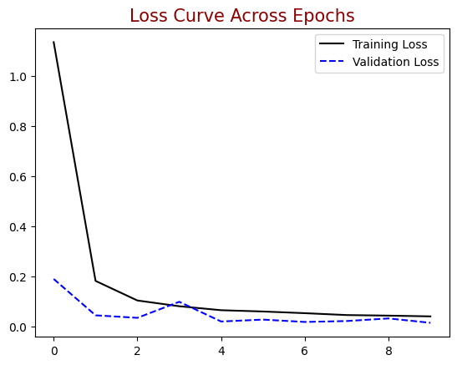
LOSS CURVE
This graph shows how the training loss and validation loss change during each epoch.
Loss measures how well the model is learning and improving over time.
A decreasing loss means the model is learning the patterns in the images correctly.
Both training and validation loss reduced steadily, indicating stable and effective learning.
The similar trend between the two curves shows that the model did not overfit.

Slide 7
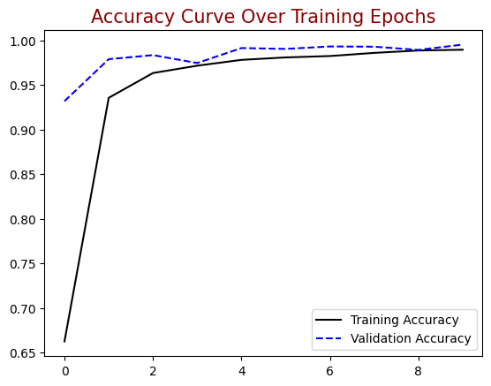
ACCURACY CURVE
This graph shows how the training accuracy and validation accuracy improved across epochs.
Accuracy indicates how correctly the model classified healthy and damaged fruit images.
Both curves steadily increased and then stabilized, showing effective learning.
The close alignment between training and validation accuracy suggests the model generalizes well.
The final accuracy levels indicate that the CNN model can reliably classify new fruit images.

Slide 8
RESULTS
The CNN model successfully classified fruit images as healthy or damaged.
Training and validation accuracy increased and stabilized, showing strong learning.
Training and validation loss decreased, indicating efficient optimization.
Final Training Accuracy: 98.99%
Final Validation Accuracy: 99.53%
Final Training Loss: 0.0385
Final Validation Loss: 0.0138
Model predictions on test images matched the actual fruit condition in most cases.
Overall, the deep learning approach proved highly effective for automated fruit damage detection.

Slide 9
CONCLUSION
The CNN model accurately distinguished healthy and damaged fruits, achieving strong performance on both training and validation sets.
The model reached a training accuracy of 98.99% and validation accuracy of 99.53%, showing excellent generalization.
Loss values decreased steadily, confirming stable learning and proper optimization.
Predictions on test images closely matched real fruit conditions, proving the model’s reliability.
Overall, the deep learning framework provides an effective and automated solution for fruit damage detection and quality assessment.

Slide 10
FUTURE WORK
Expanding the dataset with more fruit types and a wider range of damage patterns.
Implementing advanced deep learning models such as Vision Transformers (ViT), EfficientNet, or YOLO detectors for higher accuracy.
Integrating U-Net or other segmentation models for even more precise damage localization.
Deploying the model on mobile or edge devices for real-time fruit quality inspection.
Exploring additional data sources like hyperspectral or 3D imaging to detect internal or hidden damage.
Applying hyperparameter tuning and ensemble methods to further improve robustness and performance.

